Slide 1
System Integration, Communications, AI Pipeline, and Wiring for Perception System

Slide 2
Executive summary
Specifies the end-to-end hardware and software integration for a 360° collision-avoidance and inspection using hexacopter configuration. It details physical connections and serial/UART/CSI/USB mappings, communication protocols, message types and rates, the AI perception stack for LiDAR and stereo cameras, the voxel/ESDF mapping and kinodynamic MPC planner, timing and latency budgets, and comprehensive calibration, testing, and deployment steps. The SIYI ZR30 optical zoom is used exclusively for manual/automated inspection and streams to the GCS

Slide 3
System
Sensors:
  S2 LiDAR (2D) → Serial/USB → Jetson
  Servo (PWM) → Jetson MCU / PWM controller (for LiDAR rotation control)
  Stereo Cameras (IMX219) × 8 (4 stereo pairs) → Jetson CSI lanes / USB3 (if needed)
  SIYI ZR30 gimbal camera → Gimbal controller → Jetson or Cube+ / GCS (RTSP)
  GNSS #1 → Cube+ UART1 (primary)
  GNSS #2 → Cube+ UART2 or CAN (redundant)
  IMU → Cube+ (internal), Jetson receives attitude from Cube+ via MAVLink
Compute: Jetson Orin Super Nano (perception, mapping, planning) ↔ Cube+ (flight control) via MAVLink (UART4 @ 921600 or Ethernet/UDP)
Telemetry Radio ↔ Cube+ UART3 → GCS (Mission Planner/QGroundControl) over MAVLink
Power distribution: Battery → Power module (voltage/current measurement) → ESCs & DC-DC regulators for 5V/12V rails (Jetson, cameras, Cube+, LiDAR, servo, gimbal)

Slide 4
Flight controller (Cube+) physical ports
Power & telemetry:
  Power-in: from PDB / power module (safe V + current sense to FC).
  UART1 (TELEM1): GNSS #1 (UBX / NMEA) — TTL UART. Baud: 115200.
  UART2 (TELEM2): GNSS #2 or secondary telemetry — TTL or CAN (if GNSS over CAN). Baud: 115200.
  UART3 (RADIO): Telemetry radio (433/915 MHz) — TTL UART. Baud: 57600 or 115200 (match radio); modern radios can do 57600 for robust comms or higher if link supports.
  UART4 (COMPANION): Companion computer (Jetson) interface — MAVLink v2. Baud recommended: 921600 for high-bandwidth, low-latency. If using UDP: companion Ethernet → Cube+ via companion link is possible (MAVLink over UDP).
CAN: optional for CAN GNSS or other CAN devices.
I/O:
  PWM outputs: ESCs / servos (ESC signal lines via PWM / DShot depending on ESC).
AUX ports: for gimbal trigger / camera control if integrated

Slide 5
Sensor wiring summary table
Component | Physical link | To | Protocol | Baud/ Rate | Notes
GNSS #1 | TTL UART | Cube+ UART1 | NMEA/UBX | 115200 | Primary GPS supports L1 ,L5,L2 band
GNSS #2 | TTL UART/ CAN | Cube+ UART2 / CAN | NMEA/UBX or CAN | 115200 | Redundant supports L1 ,L5,L2 band
Telemetry radio | TTL UART | Cube+ UART3 | MAVLink v2 | 57600 / 115200 | To GCS
Jetson | TTL UART/ Ethernet | Cube+ UART4 / Ethernet | MAVLink v2 | 921600 (serial) or UDP | Obstacle msgs / VIO pose
S2 LiDAR | USB/ TTL UART | Jetson USB/UART | LiDAR vendor serial | 115200–921600 | Servo angle timestamps required
LiDAR servo | PWM (5V) | Jetson MCU / PWM controller | PWM | 50 Hz control | Time-sync with LiDAR scans
Stereo pairs (×4) | CSI/ USB3 | Jetson CSI lanes / USB3 | MIPI CSI-2 / UVC | up to Gbps | Use grayscale to reduce bandwidth
IMU | Internal to Cube+ | Cube+ | SPI/I²C | 400–1000 Hz | FCU primary attitude source
SIYI ZR30 gimbal | UART/ Ethernet | Jetson/Cube+/GCS | Vendor protocol / MAVLink GIMBAL | 115200 / Ethernet | Video: RTSP/H.264 stream
Power module | I2C / ADC | Cube+ | Power telemetry | — | Reports voltage/current to FCU

Slide 6
Communication protocols & message flows (fully detailed)
1 MAVLink overview (central comms)
MAVLink v2 is the canonical messaging layer between Cube+, Jetson, Telemetry Radio, and GCS. Use mission planner (Mission Planner or QGroundControl) as GCS.
Primary message types used:
  HEARTBEAT — status & heartbeat (FCU/companion).
  HEARTBEAT/STATUSTEXT — health/warnings.
  ATTITUDE, GLOBAL_POSITION_INT, LOCAL_POSITION_NED — FCU pose telemetry.
  DISTANCE_SENSOR — single sensor distances (LiDAR).
  OBSTACLE_DISTANCE — sectorized obstacle distances (used by FCU for local avoidance).
  VISION_POSITION_ESTIMATE / VISION_SPEED_ESTIMATE — VIO or Jetson-provided pose/speed estimates.
  SET_POSITION_TARGET_LOCAL_NED / SET_POSITION_TARGET_GLOBAL_INT — Jetson commanded setpoints/avoidance setpoints.
  MISSION_* — for mission upload / download (from Mission Planner).
  GOPRO_CONTROL* or vendor-specific messages for gimbal control if needed; otherwise MOUNT_CONTROL / MAVLink gimbal messages.
  PARAM_* — parameter read/write.
Flow:
  Jetson publishes OBSTACLE_DISTANCE and, when necessary, SET_POSITION_TARGET_LOCAL_NED to request avoidance maneuvers.
  Cube+ publishes ATTITUDE and LOCAL_POSITION_NED. Jetson subscribes to these for ego-state.
  Cube+ applies flight laws; ensure Cube+ parameter configuration accepts companion overrides (use GUIDED mode or set the appropriate acceptance of SET_POSITION_TARGET).

Slide 7
2 Jetson ↔ Cube+ (Companion link)
Physical: UART4 TTL level or Ethernet. Use 921600 baud for high throughput if serial. For Ethernet use 1 Gbit link and MAVLink over UDP.
Messages from Jetson to Cube+:
  OBSTACLE_DISTANCE (sectorized): Jetson calculates an array of distances around vehicle (e.g., 36 sectors at 10° each) and sends it at ~5–10 Hz.
  DISTANCE_SENSOR for single LiDAR distance in the forward sector (higher rate).
  VISION_POSITION_ESTIMATE (if Jetson VIO more accurate than GNSS for short-term) at ~10–30 Hz.
  SET_POSITION_TARGET_LOCAL_NED for direct avoidance commands or guidance velocity targets.
Messages from Cube+ to Jetson:
  ATTITUDE and LOCAL_POSITION_NED at 50–200 Hz (depending on FCU config). Jetson uses these for ego-motion compensation.
  PARAM_VALUE and STATUSTEXT for status/diagnostics.

Slide 8
3 LiDAR data handling
LiDAR outputs range readings for a 2D scan line at its internal scan rate (e.g., 10–20 Hz). Jetson reads raw range + intensity + time stamp.
Servo angle: Jetson or MCU must timestamp servo position for each scanline so transforms into vehicle frame can be done accurately. If servo angle is not timestamped, the resulting pointcloud will have motion distortion.
Pointcloud assembly:
  For each LiDAR scanline (range array), tag with servo angle θ(t) → transform polar to local 3D points in Jetson. Combine many scanlines over servo sweep to build 3D cloud.
Message to Cube+: Jetson sends DISTANCE_SENSOR for critical single-beam distance (forward) and OBSTACLE_DISTANCE for sector summaries (after fusing LiDAR + stereo).

Slide 9
4 Stereo & camera data handling
Camera transport: CSI/MIPI preferred for low-latency. Use hardware sync when possible (frame sync line) so stereo images from left-right are tightly time-aligned.
Image rate & resolution: typical 640×480@30 fps for side/rear; forward pair may be 1280×720@30 fps. Use grayscale capture for stereo matching to reduce bandwidth.
Stereo computation: Jetson runs optimized stereo network (TensorRT) yielding disparity maps → depth maps. Depth maps are aligned to vehicle frame using camera extrinsics and VIO pose.
Image detection: YOLOv8 runs on RGB frames producing bounding boxes and class probabilities. These are projected to 3D using depth to produce 3D detections for fusion.
Message to Cube+: fused obstacles are summarized in OBSTACLE_DISTANCE and SET_POSITION_TARGET as needed.

Slide 10
AI perception pipeline end-to-end (algorithmic detail)
This section explains the algorithms, data flow, training, and runtime optimizations end-to-end: LiDAR → stereo → fusion → mapping → planning.
1 Raw data ingestion & sync
Time sync is critical. Use PTP / NTP for network devices and hardware timestamps for sensor devices where possible. Jetson should maintain a monotonic clock and annotate arrivals with high-resolution timestamps.
Buffers / ring buffers: create ring buffers for LiDAR scanlines, camera frames, IMU samples, and servo angles. Align using timestamps.
2 Ego-motion estimation (VIO / VIO+GNSS)
VIO (VINS-Fusion) runs on stereo + IMU to produce high-rate short-term accurate pose. If GNSS is good, integrate GNSS for global drift correction.
Role: provide pose(t) for de-warping LiDAR scans and to place stereo depth in world frame.

Slide 11
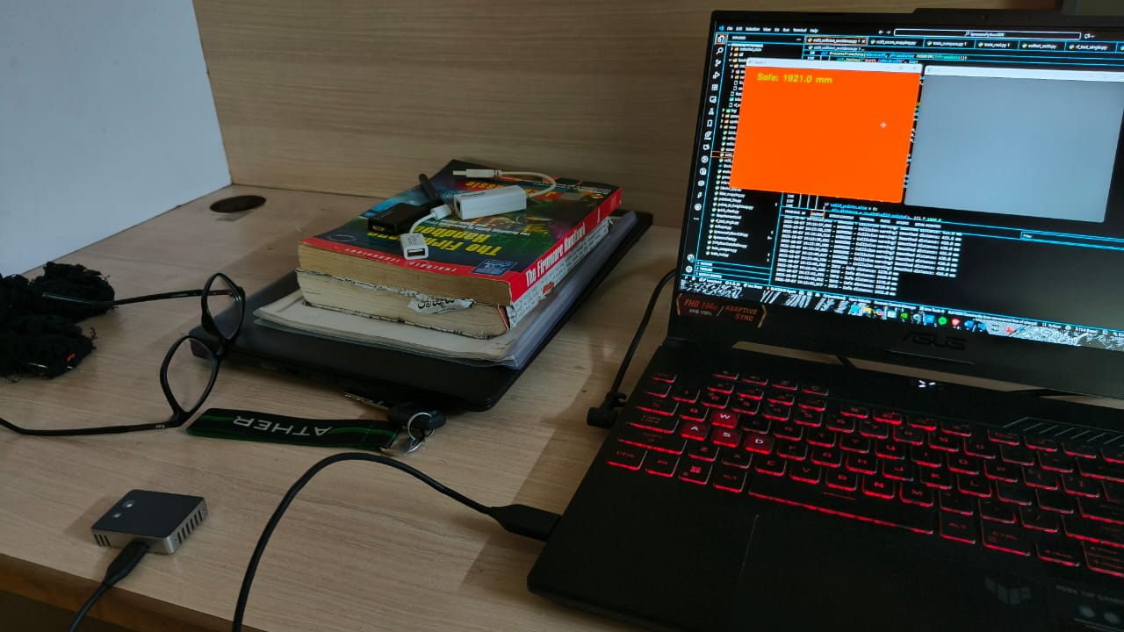
Tested Samples
FACING FLAT SURFACE

Slide 12
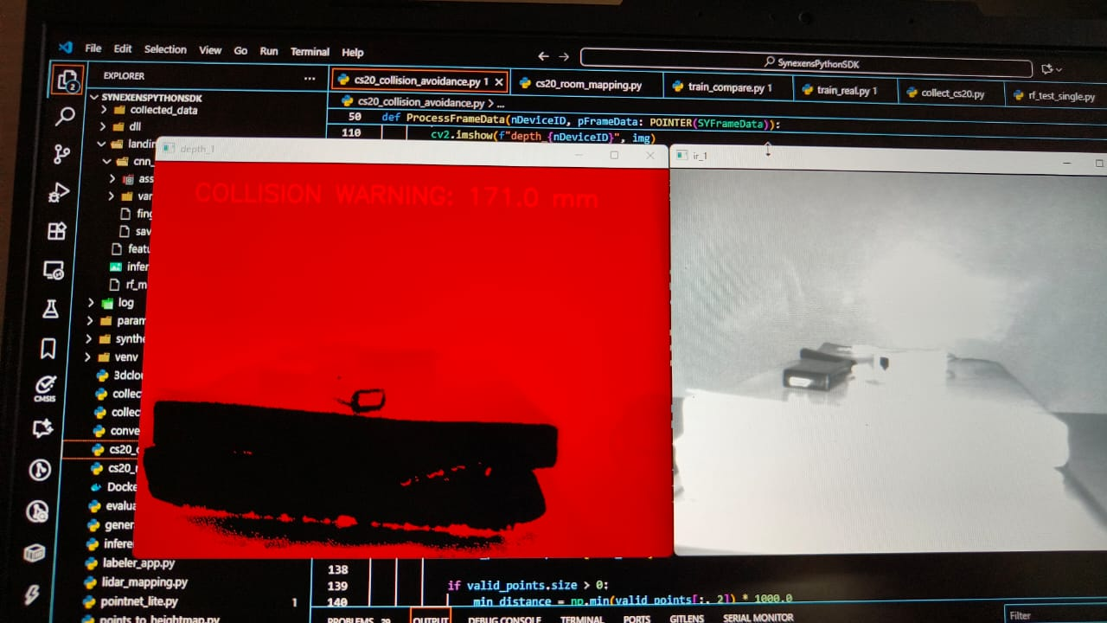
UNEVEN SURFACE

Slide 13
3 LiDAR processing
Preprocess: filter invalid returns, apply intensity thresholding.
Time + Servo unwarp: convert each 2D scanline using servo angle θ(t) and vehicle pose at timestamp t to produce 3D points.
Voxelization / downsample: for speed, use an adaptive downsampling (voxel grid of 0.05–0.1 m depending on region).
Detection: run PointPillars (fast):
  Pillarize pointcloud (bird’s-eye view grid), extract pseudo-image features, run 2D conv detection.
  Output: 3D bbox, class, confidence, velocity (if CenterPoint used).
Semantic segmentation (optional): RangeNet++ to and classify points (tower/pole/vegetation/bird).
Outputs: 3D detections with positions & confidences, per-point labels for painting.
4 Stereo depth & image detection
Stereo matching: StereoNet/PSMNet-small. Produce disparity map D(x,y). Apply sub-pixel refinement (soft-argmax or quadratic fit) to get fractional disparities reducing quantization error.
Depth map: Z(x,y) = f_px * B / D(x,y). Mask low-confidence disparities (matching cost thresholds).
Image detection: YOLOv8 returns 2D boxes + scores. Run semantic segmentation (BiSeNet) optionally for point painting.
Project to 3D: Using camera intrinsics & VIO pose, project image detections with depth into 3D coordinates in the vehicle frame.
Outputs: dense depth for sectors, 3D boxes from stereo-assisted 2D detection

Slide 14
5 Fusion: point-painting & detection consolidation
Point-painting: augment LiDAR points by projecting camera segmentation/detections into LiDAR point cloud and adding semantic labels. This helps detection networks by giving image-aware points.
Score fusion: for overlapping LiDAR & stereo detections, fuse using a weighted scheme: LiDAR weight increases with distance and intensity; stereo weight increases with disparity confidence; image detection weight from YOLO score.
Result: fused obstacle list with class, 3D box, distance & velocity (from tracker), and per-obstacle confidence.

Slide 15
6 Tracking & prediction
3D Kalman / Extended Kalman filter per tracked object estimating position & velocity in local frame. Use constant-velocity or constant-acceleration motion models.
Data association: nearest-neighbor + IoU matching (3D CBV IoU) with gating based on expected motion.
Prediction: estimate short-term future positions (1–5 s) and compute TTC (time-to-collision) with the drone’s current trajectory.
7 Mapping: TSDF → ESDF (Voxblox)
TSDF: integrate fused pointclouds into a Truncated Signed Distance Field (TSDF) at voxel resolution 0.1 m (or 0.05 m in near field). This yields surface reconstructions.
ESDF: compute ESDF (distance-to-nearest-obstacle) from TSDF to provide smooth distance fields for planning. Recompute ESDF each map update in the local window (costly but optimized libs exist).

Slide 16
7 Mapping: TSDF → ESDF (Voxblox)
TSDF: integrate fused pointclouds into a Truncated Signed Distance Field (TSDF) at voxel resolution 0.1 m (or 0.05 m in near field). This yields surface reconstructions.
ESDF: compute ESDF (distance-to-nearest-obstacle) from TSDF to provide smooth distance fields for planning. Recompute ESDF each map update in the local window (costly but optimized libs exist).
8 Kinodynamic planning (MPC) using ESDF
Planner input: current pose & velocity (from VIO + FCU), target waypoint, local ESDF.
Cost:
  path tracking (minimize deviation from mission waypoint)
  control effort (minimize acceleration & jerk)
  collision penalty (exponential penalty for voxels where ESDF < safety_distance)
Constraints: max velocity v_max, max accel a_max, jerk limits.
Solver: small-horizon MPC (1–3 s horizon) running at 10–30 Hz. Use ESDF gradients to push trajectory away from obstacles.
Output: smooth velocity/position target to Jetson/Cube+; Jetson issues SET_POSITION_TARGET_LOCAL_NED or SET_ATTITUDE_TARGET depending on integration; Cube+ executes closed-loop.

Slide 17
Communication protocols, message flows, pros & cons
1. Jetson ↔ Cube+ (Companion link)
Physical: TTL UART (UART4) at high baud (recommended 921600), or Ethernet (UDP) if you use a companion network.
Logical: MAVLink v2.
Messages Jetson → Cube+:
OBSTACLE_DISTANCE — fused sectorized obstacle distances (e.g., 36 sectors). Recommended publish rate: 5–20 Hz.
DISTANCE_SENSOR — direct LiDAR front-beam values at higher rate (10–50 Hz).
VISION_POSITION_ESTIMATE / VISION_SPEED_ESTIMATE — VIO pose & speed (10–30 Hz) when Jetson VIO is better than GNSS short-term.
SET_POSITION_TARGET_LOCAL_NED — avoidance setpoints or immediate velocity targets (on-demand, event-driven).
Messages Cube+ → Jetson:
ATTITUDE (50–200 Hz) — FCU attitude for sensor compensation.
LOCAL_POSITION_NED (20–50 Hz) — local pose.
STATUSTEXT, PARAM_VALUE — status & configuration.

Slide 18
Advantages
Low-latency control path for immediate avoidance commands (921600 serial is fast).
Well-supported ecosystem (Mission Planner / QGC) integrates readily with MAVLink.
Clear message types for obstacle reporting and setpoints.
Disadvantages
UART at 921600 can be affected by EMI and long cable runs — keep cable short and shielded; use twisted pair and ferrites.
Companion overrides must be carefully gated in Cube+ parameterization to avoid unsafe commands from buggy Jetson code.
If using UDP/Ethernet, you gain bandwidth but add complexity (network stack, IP addressing, NAT with GCS if remote).
Operational notes
Use parity/error checking and consider a small watchdog on Cube+ that rejects SET_POSITION_TARGET commands that violate safe limits (max speed/altitude).
Keep a heartbeat policy: if Jetson heartbeat not seen, Cube+ should disable companion overrides and revert to RTH / mission.

Slide 19
2 Cube+ ↔ GCS (Telemetry radio)
Physical: Radio module on Cube+ UART3 → GCS (3 km or more link as spec).
Logical: MAVLink v2.
Messages & flows
Full vehicle telemetry (heartbeat, attitude, position, battery, mission).
Operator receives obstacle alerts relayed (statustext or custom MAVLink messages).
Mission upload/download (waypoints, geofence).
Operator can command SIYI gimbal if linked through Jetson/Cube+.
Advantages
Standard, proven link for remote control.
GCS tools (Mission Planner / QGC) parse MAVLink and provide operator UI.
Disadvantages
Telemetry radios have limited bandwidth — avoid high-bitrate streaming over the same link (do not send raw video).
Outdoor range and reliability affected by terrain and EMI from HV lines; plan for intermittent dropouts.
Operational notes
Stream only metadata/alerts over telemetry. For video, use separate high-bandwidth link (Wi-Fi/4G/5G/RTSP over cellular) or low-res thumbnail over MAVLink.
Auto-RTH on long telemetry dropout should be configured conservatively with operator overrides.

Slide 20
3 Jetson ←→ LiDAR (S2) & Servo control
Physical: LiDAR → Jetson via USB or TTL serial; servo angle feedback via PWM/encoder to Jetson or MCU.
Messages
LiDAR → Jetson: raw range array + timestamp + intensity.
Jetson → servo MCU: PWM commands for angle control (or target angle via serial) and request for angle timestamps (or read encoder).
Advantages
LiDAR gives precise range returns (cm-level) and works at night.
Servo + LiDAR arrangement provides 3D by scanning.
Servo moves 90 - 120 degrees in 2 secs for 3D mapping.
Disadvantages
LiDAR + servo 3D update rate depends on servo rotation speed — may be slow for high-speed flight if not planned.
LiDAR sensitive to atmospheric scatter (rain/fog/dust) and reflective surfaces.
Operational notes
Timestamp LiDAR scanlines and servo angle with microsecond precision. Use a hardware PWM driver or MCU with encoder for reliable angular feedback — do not rely on open-loop servo commands only.
Provide mechanical slip-ring or cable routing for continuous 360° rotation if needed.

Slide 21
4 Jetson ←→ Stereo Cameras (IMX219 pairs)
Physical: CSI/MIPI preferred; if insufficient CSI lanes use USB3 UVC cameras.
Messages
Camera streams → Jetson: frames (grayscale preferred for stereo), per-frame timestamps.
Jetson runs stereo inference and publishes depth maps and 3D detections to fusion node.
Advantages
Stereo provides dense depth map in textured scenes and is cheap/low-power.
Good for classification (bird vs pole) via image detectors.
Disadvantages
Passive sensor — fails in low light, glare, and low-texture surfaces.
High bandwidth — manage resolution/FPS tradeoffs.
Sensitive to motion blur at high speed; use higher shutter speed and more light.
Operational notes
Use hardware frame sync (if camera modules support) to ensure left-right frames are coherent.
Prefer grayscale stereo at real-time; reserve RGB at lower rates for detection/classification.

Slide 22
5 SIYI ZR30 Gimbal → GCS / Jetson
Physical: Gimbal controller ↔ Jetson (UART/Ethernet) and/or direct stream to GCS via RTSP.
Messages
Gimbal telemetry & control via vendor protocol or MAVLink GIMBAL messages.
Video streamed via RTSP/H.264 to operator for inspection.
Advantages
High-quality optical zoom for inspection (20×); good for detailed visual inspection when hovering.
Operator-driven — reduces demand on autonomy for inspection tasks.
Disadvantages
Narrow FOV at high zoom; image stabilization needed.
Mechanical complexity: moving parts risk in dust/wet environments.
Operational notes
Use gimbal-safe interlocks (do not allow large gimbal motions during aggressive maneuvers).
Stream video separately from MAVLink (use Jetson as transcode/RTSP server if needed).

Slide 23
Latency, rates & timing budgets (practical targets)
Aim to keep end-to-end perception-to-command latency ≤ 200 ms. Lower is better.
1 Example budget (target)
Camera capture & transfer to Jetson: 10–20 ms (CSI).
Stereo depth inference (per prioritized pair): 20–50 ms (TensorRT FP16).
Image detection (YOLOv8 tiny) per frame: 10–30 ms.
LiDAR read + servo timestamp: 10–30 ms per scanline; assembly of partial cloud: 20–50 ms depending on sweep.
Fusion & mapping update (TSDF/ESDF incremental): 20–40 ms (optimized).
Tracking & prediction: <10 ms.
MPC planning & setpoint generation: 10–30 ms.
MAVLink transfer to Cube+: <10 ms (serial at 921600).
Cube+ actuation + control loop response: ~50 ms (to start applying control).
Total ~ 160–270 ms depending on concurrency. Profile and reduce by parallelism and CPU/GPU optimization.

Slide 24
2 Message rates suggestions
ATTITUDE: 50–100 Hz from Cube+.
LOCAL_POSITION_NED: 20–50 Hz.
OBSTACLE_DISTANCE: 5–20 Hz (more frequent if obstacle density high).
DISTANCE_SENSOR: 10–50 Hz for direct LiDAR front beam.
Jetson internal processing loops: perception @ 10–30 Hz (full fused updates), stereo forward pair faster @ 30 fps if possible for forward reaction.

Slide 25
Calibration & alignment (must-have steps)
Intrinsic camera calibration — for each IMX219 camera: focal length, principal point, distortion coefficients. Use checkerboard or chessboard calibration. Save YAML intrinsics.
Stereo extrinsics — left-right transform (R, t) per stereo pair. Use stereo calibration tools (OpenCV stereoCalibrate) and refine with bundle-adjusted sequences.
Camera ↔ LiDAR extrinsics — rigid transform between LiDAR and one camera frame. Use calibration rigs or automatic calibration (e.g., by detecting same features in both modalities). Record and verify.
LiDAR servo mapping — verify servo angle to physical transform mapping: angle → rotation axis calibration to ensure accurate pointcloud alignment.
IMU ↔ camera / IMU ↔ LiDAR — calibrate time offset and transform. IMU offset critical for VIO accuracy.
GNSS → local frame alignment — verify offsets and correct NED/ENU conventions.
Jetson ↔ Cube+ time sync — configure time sync (NTP/PTP) or use MAVLink timestamps conversion.
Motor & ESC calibration — calibrate throttle endpoints, failsafe throttle.
Gimbal calibration — ensure SIYI zero positions, zoom limits, and RTSP stream validated.

Slide 26
Safety, failsafe, and degradation modes
1 Mandatory failsafes
Dual GNSS: automatic switchover. If both GNSS degrade, Jetson triggers VIO-only navigation within limited area and reduces speed.
Companion failure: if Jetson fails/unavailable, Cube+ uses preplanned contingency: reduce speed, enter fail-safe loiter, and perform RTH if necessary.
Telemetry loss: auto RTH and safe loiter in case of long telemetry blackout.
Low battery: Cube+ to enforce RTL when battery below threshold with return margin.
Obstacle detection overrides: Jetson-issued avoidance has high priority but Cube+ should have a safety veto (e.g. prevents Jetson from issuing commands that violate hard constraints like exceed motor limits). Use parameter COM_OBL_ACT style mapping.
2 Graceful degradation
Night/Low light: Jetson detects low stereo confidence and increases weighting of LiDAR; automatically reduces v_max.
Heavy rain/fog: LiDAR returns confidence drop — increase safety buffer and force slow speed / land if necessary.
High EMI near power lines: GNSS may degrade — rely on VIO and ensure operator notified via GCS.

Slide 27
Numeric worked examples (three commonly used angular resolutions)
1) S = 360 samples/scan; F = 15 Hz
pps = 360 × 15 = 5,400 pts/s
B/s = 5,400 × 16 = 86,400 B/s = 0.0864 MB/s (≈ 0.69 Mb/s)
Points in T=3 s → 5,400 × 3 = 16,200 pts
  Memory to store those points = 16,200 × 16 = 259,200 B ≈ 0.259 MB
Points in T=5 s → 5,400 × 5 = 27,000 pts → memory = 27,000 × 16 = 432,000 B ≈ 0.432 MB
points_per_tick at R_map=10 Hz → 5,400 / 10 = 540 pts/tick
points_per_tick at R_map=15 Hz → 5,400 / 15 = 360 pts/tick
2) S = 720 samples/scan; F = 15 Hz (typical mid-density)
pps = 720 × 15 = 10,800 pts/s
B/s = 10,800 × 16 = 172,800 B/s = 0.1728 MB/s (≈ 1.38 Mb/s)
Points in T=3 s → 10,800 × 3 = 32,400 pts → memory = 32,400 × 16 = 518,400 B ≈ 0.518 MB
Points in T=5 s → 10,800 × 5 = 54,000 pts → memory = 54,000 × 16 = 864,000 B ≈ 0.864 MB
points_per_tick at 10 Hz → 10,800 / 10 = 1,080 pts/tick
points_per_tick at 15 Hz → 10,800 / 15 = 720 pts/tick
3) S = 1440 samples/scan; F = 15 Hz (high-density)
pps = 1440 × 15 = 21,600 pts/s
B/s = 21,600 × 16 = 345,600 B/s = 0.3456 MB/s (≈ 2.76 Mb/s)
Points in T=3 s → 21,600 × 3 = 64,800 pts → memory = 64,800 × 16 = 1,036,800 B ≈ 1.037 MB
Points in T=5 s → 21,600 × 5 = 108,000 pts → memory = 108,000 × 16 = 1,728,000 B ≈ 1.728 MB
points_per_tick at 10 Hz → 21,600 / 10 = 2,160 pts/tick
points_per_tick at 15 Hz → 21,600 / 15 = 1,440 pts/tick

Slide 28
Voxel (TSDF) mapping: How many voxels get created/updated?
We estimate unique voxels in the T-second map snapshot and voxel updates/sec the mapping must perform.
unique_voxels_in_T ≈ (points_in_T) × f_uniq
voxel_memory ≈ unique_voxels_in_T × bytes_per_voxel (assume 16 B/voxel)
voxel_updates_per_second ≈ pps × k, where k is the average number of voxels a single point updates (depends on TSDF truncation radius). Conservative k ≈ 8 (voxel neighborhood touched per integrated ray); pick 8 as baseline.
Using f_uniq = 0.6 and k = 8 (conservative for 2D-lidar-derived clouds):
Example (S = 720, F = 15) — mid-density (most realistic)
points_in_3s = 32,400 → unique_voxels ≈ 32,400 × 0.6 = 19,440 voxels
  voxel memory ≈ 19,440 × 16 B = 311,040 B ≈ 0.311 MB
points_in_5s = 54,000 → unique_voxels ≈ 54,000 × 0.6 = 32,400 voxels
  voxel memory ≈ 32,400 × 16 = 518,400 B ≈ 0.518 MB
voxel_updates_per_second ≈ pps × k = 10,800 × 8 = 86,400 writes/sec
voxel_updates_per_tick (R_map = 10 Hz) = 86,400 / 10 = 8,640 writes/tick
  (At 15 Hz → 86,400 / 15 = 5,760 writes/tick.)
Example (S = 360, F = 15)
points_in_3s = 16,200 → unique_voxels ≈ 9,720 → mem ≈ 155,520 B (0.156 MB)
voxel_updates/sec ≈ 5,400 × 8 = 43,200 → per tick @10Hz = 4,320 writes
Example (S = 1440, F = 15)
points_in_3s = 64,800 → unique_voxels ≈ 38,880 → mem ≈ 622,080 B (0.622 MB)
voxel_updates/sec ≈ 21,600 × 8 = 172,800 writes/sec → per tick @10Hz = 17,280 writes

Slide 29
Practical recommendations & knobs you should tune now
Use sparse hashed TSDF (Voxblox) — minimal memory & very fast for LiDAR-only mapping.
Keep R_map = 10–15 Hz as you specified; for S=720 & F=15 each tick processes only a few thousand voxel writes — feasible.
Use encoder/servo timestamps to correctly place points in world frame before insertion. Even though points/sec is modest, timestamp accuracy matters for moving drone.
Cap TSDF truncation radius to limit k (voxels updated per point) — smaller truncation reduces writes. For v=0.1 m, use truncation 0.2–0.3 m.
Limit ESDF recompute radius to local band (e.g., 10–15 m) rather than global recompute each tick.
Log only TSDF snapshots or small pointcloud extracts for offline debugging — raw LiDAR logs are tiny but full-rate continuous logging is usually unnecessary.
Profile early: measure your actual S and F and use these numbers to size exact CPU/GPU kernels. The theoretical numbers above are small; optimizations will make it smooth.

Slide 30
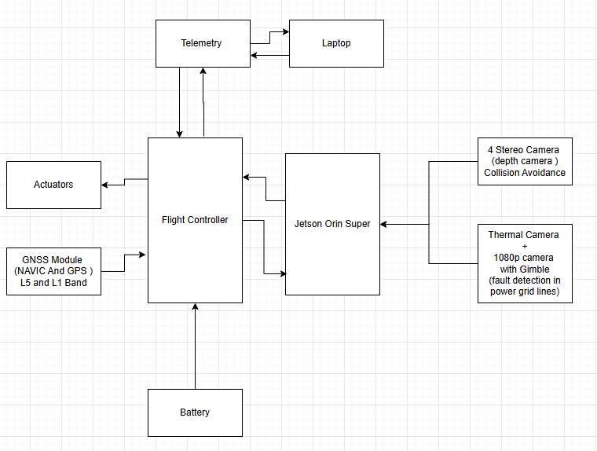
INTEGRATION BLOCK DIAGRAM

Slide 31
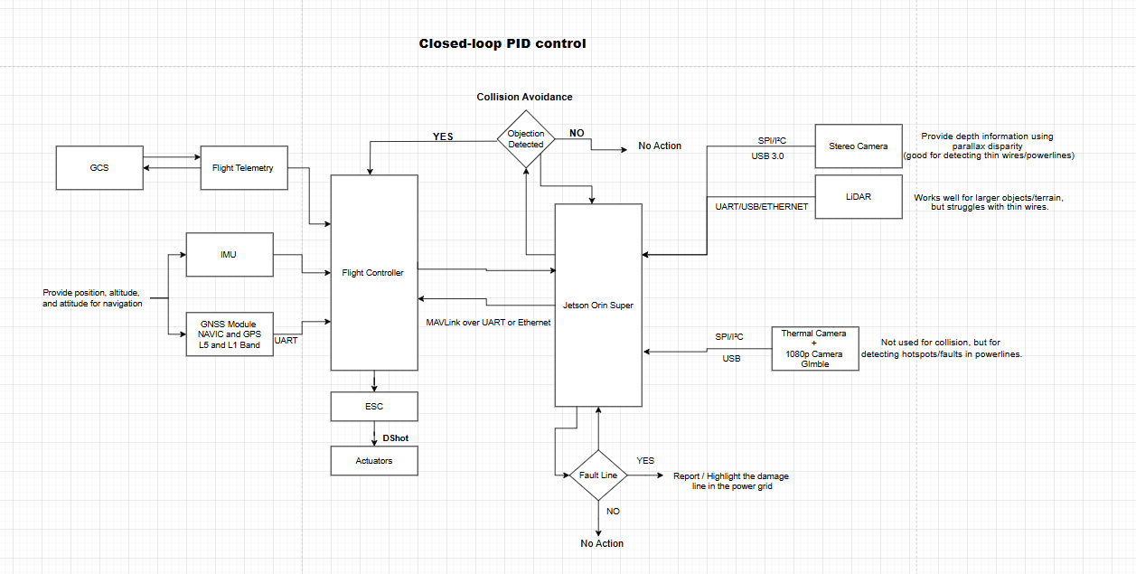

Slide 32
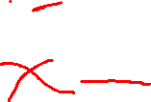

Slide 33
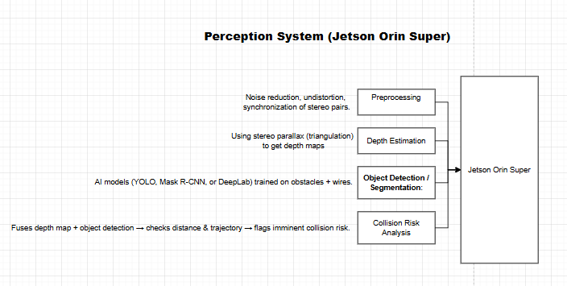

Slide 34
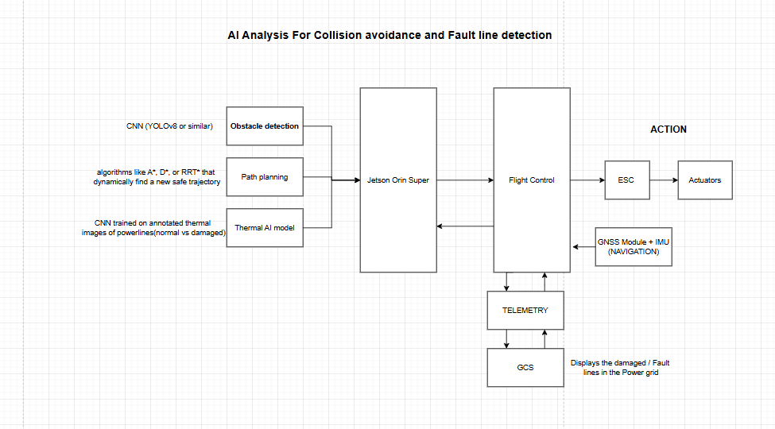

Slide 35
Simplified 360 Degrees Collision Avoidance Perception System
1. Long-Range 360° LiDAR (Primary Obstacle Detection)
Specs
Type: 360° 2D scanning LiDAR (e.g., RPLIDAR A3, Leishen M10, RPLIDAR S2L).
Range: 0.15–25 m (effective 10 m used for collision bubble).
Rate: 10–15 Hz scan refresh.
Samples per scan: 720–1440 points.
Data rate:
  Assume 10,800 points/s × 16 B (x,y,z,intensity float32) ≈ 0.17 MB/s (~1.4 Mbps).
Protocol : Power
RPLIDAR A3: ~2 W (5 V, 400 mA).
Leishen M10: 3–5 W depending on model.
RPLIDAR S2L: ~3W

Slide 36
Integration
Connected directly to Cube+ (via UART) or Jetson → sends OBSTACLE_DISTANCE MAVLink messages.
No AI needed — simple geometric thresholding.
Advantages
Simple & reliable long-range sensing (10 m bubble).
Low compute load.
Works in real-time with ArduPilot/QGC.
Disadvantages
Struggles with thin wires and transparent obstacles.
Only provides 2D slice (no height info).
Sunlight/rain/fog can reduce range.

Slide 37
2. Stereo Cameras ×4 (Short-Range Redundancy)
Specs
Modules: IMX219 stereo (per side).
Resolution:
  Forward: 1280×720 @ 30 FPS
  Sides: 640×480 @ 30 FPS
Depth Accuracy: ~±2 cm within 5–8 m.
Bitrate (raw):
  Forward cam: 1280×720×30 FPS ≈ 22 MB/s ≈ 176 Mbps
  Side cam: 640×480×30 FPS ≈ 9 MB/s ≈ 72 Mbps
  Four cams ≈ ~392 Mbps raw (processed locally on Jetson).

Slide 38
Protocol
CSI (MIPI) or USB3.
Processing on Jetson → compresses to depth map.
Power
Each stereo cam ≈ 2–3 W.
Four total ≈ 8–12 W.
AI Processing
Jetson runs a lightweight model (YOLO-tiny, MobileNet-SSD, or line detection CNN).
Output: detected obstacles (wires, poles, people) → send avoidance setpoints to Cube+.
Advantages
Detects thin wires LiDAR misses.
Full 360° redundancy.
AI flexibility for object classification.
Disadvantages
High bandwidth → must process locally.
Sensitive to lighting (night/day, glare).
Power-hungry compared to LiDAR.

Slide 39
Communication Links Summary
Link | Protocol | Data Rate | Purpose
LiDAR → Cube+/Jetson | UART/USB | ~1.4 Mbps | Obstacle distances
Stereo → Jetson | CSI/USB3 | ~392 Mbps raw | Depth maps + AI
Jetson → Cube+ | MAVLink v2 | <100 kbps | Avoidance setpoints
Jetson → GCS | RTSP/WebRTC | 5–8 Mbps | Inspection video
Gimbal → Jetson | RTSP/UART | 5–8 Mbps + 115 kbps | Video + PTZ control
Telemetry → GCS | MAVLink v2 | 57–115 kbps | Flight control/telemetry

Slide 40
Power Consumption Summary
Component | Power (W)
LiDAR | 2–5 W
Stereo cams (×4) | 8–12 W
Gimbal (SIYI ZR30) | 15–25 W
Jetson Orin | 20–40 W
Cube+ FCU | 3–5 W
Telemetry Radio | 3–5 W
Total | ~55–90 W (electronics only, not motors)

Slide 41
Advantages vs Disadvantages
Advantages
LiDAR bubble (10 m): simple, reliable, no AI required.
Stereo cameras: redundancy, catch wires & small obstacles.
Gimbal camera: provides inspection video independent of nav sensors.
Mission Planner/QGC: robust GCS integration, minimal custom code.
Cube+: proven, industrial-grade flight control.
Disadvantages
Stereo cameras add bandwidth + power load.
Jetson increases power use and reduces flight time.
LiDAR limited in bad weather (fog, heavy rain, bright sunlight).
Complexity (multiple sensors, multiple links).

Slide 42
Practical Flight Time Estimate
Practical Flight Time Estimate
Assume a hexacopter 7–8 kg (your drone) with 6S battery:
Hover power ≈ 400–500 W.
Add electronics ≈ 70 W.
Total ≈ ~470–570 W.
Battery life estimates (6S ~22.2 V):
5,000 mAh (111 Wh): ~12 min.
10,000 mAh (222 Wh): ~22–24 min.
15,000 mAh (333 Wh): ~33–36 min.
20,000 mAh (444 Wh): ~45–50 min.

Slide 43
In summary:
LiDAR (360°) gives you a reliable 10 m safety bubble with minimal compute.
Stereo cameras add close-range 360° AI redundancy (catch wires/lines).
Gimbal camera is dedicated for inspection (stream+record).
Mission Planner/QGC + Cube+ handles navigation and failsafe.
System tradeoff: simplicity of LiDAR vs. stereo redundancy vs. power draw.

Slide 44
SAFE SPOT LANDING
Mount CS20 facing straight down (optical axis aligned with vehicle Z). If it is offset, record the offset & set PLND_ORIENT (mount orientation) later. CS20 is typically a USB/ToF camera — connect it to your companion computer (e.g. Raspberry Pi) over USB.
Companion computer (Pi/Jetson) runs code to:
  convert CS20 depth frames → location of a safe landing target (x,y relative to camera + distance z), and
  publish MAVLink LANDING_TARGET (and optionally DISTANCE_SENSOR) to the autopilot. ArduPilot uses the LANDING_TARGET message for precision landing.
Flight controller (Pixhawk) connected to companion via TELEM port or USB. Mission Planner will show messages in MAVLink inspector when streaming correctly.

Slide 45
ArduPilot / Mission Planner parameters to set
Set these (Mission Planner → Full Parameter List). After changing parameters reboot FCU.
PLND_ENABLED = 1 (enable Precision Landing).
PLND_TYPE = 1 (use MAVLink LANDING_TARGET from companion computer).
PLND_SRCH_ALT — search altitude (m) to climb to if target lost (start with 6–10 m).
PLND_ALT_MAX — max altitude to use precision landing (final stage).
PLND_STRICT — 0 (fallback to normal land if target lost) or 1 (abort /strict). Start with 0.
PLND_ORIENT — set if camera is not mounted with x-forward, y-right.
RNGFND_TYPE / RNGFND_SCALING / RNGFND_MIN_CM / RNGFND_MAX_CM — if you provide DISTANCE_SENSOR messages from CS20, configure rangefinder settings or let ArduPilot auto-detect. Downward rangefinder data improves altitude control during final descent.
(Exact param names above are ArduPilot parameter names; check Mission Planner parameter reference before flight.)

Slide 46
What the companion computer must send
LANDING_TARGET (MAVLink) — contains either:
  angular offsets (angle_x, angle_y) + distance OR
  absolute x,y,z in MAV_FRAME_LOCAL_NED (position_valid=1). ArduPilot supports both; sending x,y,z in local frame is best if you can compute it. Send at 10–50 Hz.
DISTANCE_SENSOR (MAVLink) — publish the measured height above ground from CS20 as a rangefinder input (helps FCU altitude). Send at ~10–20 Hz
Important: during final approach ArduPilot will accept external target corrections (precision loiter/landing). If target is lost it will either continue normal landing or abort depending on PLND_STRICT.

Slide 47
Minimal Python (companion computer)
PyMAVLink. It includes:
connecting to FCU (UDP or serial),
placeholder code to read CS20 depth frames (I mark the place to call your CS20 SDK/ROS node),
simple algorithm: pick the largest flat/clear circle near center as "safe spot", compute angle offsets and distance, and send LANDING_TARGET + DISTANCE_SENSOR.
Notes before running: install pymavlink, opencv-python, and the CS20 SDK / ROS driver you use. Adjust FCU_CONNECTION to your link (e.g. /dev/ttyAMA0, udp:127.0.0.1:14550, or serial). This script is intentionally straightforward so you can adapt the detection step to your preferred depth-processing method (ROS, OpenCV, pointcloud libs).
How it works (summary):
find_safe_spot() is minimal: replace with a plane fit + obstacle detection (RANSAC plane, normal variance, slope threshold) for production. If you can detect flat area and no obstacles within the rotor downwash radius, that's a good safe spot.
Convert pixel offsets → angle_x/angle_y or compute absolute x,y,z in local NED (more precise if you can). ArduPilot accepts both when PLND_TYPE=1.

Slide 48
Practical tips, safety & testing
Simulate first: use SITL and simulate LANDING_TARGET messages before trying on real vehicle. ArduPilot docs explain precision landing workflows.
Start high PLND_SRCH_ALT so vehicle can search for target on approach if it isn’t seen. Test PLND_STRICT=0 initially (fallback to normal land).
Rate: send LANDING_TARGET at ≥ 5–10 Hz; 10–50 Hz recommended for smooth corrections.
Rangefinder: sending DISTANCE_SENSOR helps the autopilot use the camera height as a reliable altitude source for final descent (especially if barometer/GPS noisy).
Yaw alignment: if you want a particular yaw on touchdown, compute and send yaw through the landing target quaternion fields (advanced) or align yaw before entering Land mode. Some FC firmware variations handle yaw differently — test on bench.
Prop downwash & turbulence: final few meters are sensitive — ensure landing zone has enough clearance and that your large-rotor turbulence won’t move the vehicle off the pad. Consider using a bigger landing pad or net if turbulence is an issue.
Logging & MAVLink inspector: view received LANDING_TARGET in Mission Planner’s MAVLink Inspector to confirm the FCU sees your messages.

